Slide 1
S-98 Interoperability Scopes TSM7 23-26 September 2019
Raphael Malyankar
Eivind Mong
On behalf of S-100 WG Chair

Slide 2
Overview
This paper covers:
Options for defining interoperability scopes.
Re-structuring the draft S-98 interoperability specification, including the possible transfer of abstract interoperability concepts into S-100 5.0.0.
An assessment of the implications of implementing only Level 1 interoperability.
Purpose: Facilitate a limited and phased introduction of interoperability, with pauses between phases for evaluation.
This paper addresses concerns expressed at HSSC 11 and elsewhere:
How will interoperability work in practice?
Implementation should be phased. Initial efforts should concentrate on the lower, less complex interoperability levels.
Notes:
Proper scoping will facilitate phasing in interoperability with pauses between phases to evaluate the results and update the S-98 specification and implementation plan if necessary.
The question “Which products should ICs cover?” is addressed in TSM7 4.1.

Slide 3
Interoperability Levels
Level 0: No interoperability processing – just overlays, as now.
Level 1: Interoperability Catalogue (IC) specifies (modifies) the interleaving of feature types compared to the ordering in the PS’ Portrayal Catalogues.
Level 2: Type suppression + filtering + Predefined Combinations (PDCs):
Suppression of all features of a specified feature type in one product by a feature type from a different product.
Filtering by attribute values and spatial type (point/curve/surface/coverage).
PDCs are sets of data products to which a specific collection of interoperability rules apply. PDCs allow customization of interoperability for different sets of data products.
Level 3: Feature hybridization – enhancement or combination of thematic attributes of coincident features from different products. E.g., re-calculation of numeric attribute values, or adding listed values to an enumeration attribute.
Level 4: Spatially-aware interoperability. Complex spatial operations for determining whether features interact, combine feature geometry, etc.
Notes:
Level 2 and Level 3 do not include spatial operations like intersection, etc.

Slide 4
Options for S-98
Move abstract interoperability concepts into S-100. Retain S-98 as an implementation specification.
Use specification scopes (defined in S-100 Part 11) to separate interoperability levels (one S-98 document or Part, with 4 scopes).
Divide the interoperability specification into separate documents (or Parts) for separate levels.
Add a scope conformance clause with a table specifying which clauses (or Parts) of the revised S-98 belong in each scope.
Move Levels 3 & 4 into an informative document.
Prepare supporting documents: (a) Functional overview; (b) Implementation roadmap.
Change the interoperability specification into a guideline & leave technical details to OEMs.
The options are not all mutually exclusive.

Slide 5
Option 1 – separate abstract interoperability concepts and implementation
Split S-98 and absorb the abstract specification and mechanisms into a new part of S-100
S-98 itself could be a multipart implementation.
Allows S-98 to become a specification which contains the guidance to tie together various parts of ECDIS (front-of-bridge) operation.
Current elements that are contained within S-52 required for ECDIS do not have a home within the S-100 framework. For example, status report, portrayal framework, loading/unloading (this is in S-101), messages, and others. These elements make up part of the operation of the ECDIS (in the S-57 context) and facilitate the use of the ENC data for navigation while not necessarily being concerned purely with its display.

Slide 6
Option 2 – Specification scopes
Adapt the “specification scope” concept from S-100 Part 11 to interoperability levels.
S-100 Table 11-3 says how the scopes can be described. The table below is derived from that table, and shows how the levels can be described.
Name | Description | Type | Mult. | Value in S-98
scopeIdentification | Specific identification of the scope | CharacterString | 1 | S98LX (X = 1, 2, 3, or 4)
level | Hierarchical level of the data specified by the scope | MD_ScopeCode (ISO 19115-1) | 0..1 | “software”
levelName | Name of the hierarchy level | CharacterString | 0..1 | Interoperability Level X
levelDescription | Detailed description about the level of the data specified by the scope | CharacterString | 0..1 | L1: Interleaving of feature types L2: Type-based selectivity and feature class replacement L3: Feature hybridization L4: Spatial operations
coverage | Subtype of a feature that represents real world phenomena as a set of attributes | CharacterString | 0..1 | (not used)
extent | Spatial, vertical and temporal extent of the data | EX_Extent (ISO 19115-1) | 0..1 | EX_Extent.description = “‍worldwide” EX_GeographicBoundingBox = [-‍180, +‍180, -‍90, +‍90]

Slide 7
Option 3 – Distinct Parts for each level
Reorganize the interoperability specification as Parts A-D.
Each Part contains all the information for a single level in a one compartment, including fragments of the UML model, XML schemas, interoperability portrayal rules, etc.
Both abstract concepts and implementation could be (separately) sub-divided.
Compartments provide identifiable references for interoperability levels.
E.g., a hypothetical IEC ????? or IMO MSC ??? can specify interoperability L1+L2 by saying “Implement S-98 Parts A and B.” (or S-100 Parts 16A & 16B).

Slide 8
Option 4 – Scope conformance clause
Alternative or supplement to option 3 (distinct Parts for levels).
Add a conformance clause with a table specifying which clauses (or Parts) of the revised interoperability specification belong in each scope.
This would be largely redundant if Option 3 is accepted.

Slide 9
Option 5 – Make Levels 3 and 4 an Annex
Describe Levels 3 and 4 in an informative Annex.
Information pertaining to Levels 3 and 4 should be published, because Levels 3 and 4 address potential problems which are not resolved in Levels 1 and 2.
Decisions as to whether and when Levels 3 and 4 come into effect can be made later based on experience with Levels 1 and 2.

Slide 10
“Option” 6 – Add supporting documents
Functional Overview.
The draft interoperability functional overview document should be revised to address feedback received and to conform to the final structure of the S-98 1.0.0.
Implementation Roadmap
Some or all dates and intervals can be notional, and fixed as implementation progresses. E.g., in the initial version planned dates for Levels 2 and higher can be notional.

Slide 11
Option 7 – change S-98 into a guideline
Change S-98 into a guideline of visuals for how interoperability should work on the screen, and leave the technical implementation details to OEMs.
S-98 becomes a cartographic document that elaborates the priorities for each data object in the described scenarios.
The guideline would also have to describe if scenarios not described are permissible and how much freedom the OEMs and users would have.
Type approval like S-64, with IHO supplying test data and reference screen shots and the type approver comparing the image with reference screen shot.

Slide 12
Which levels to implement initially?
L1 only: In case of similar features in different products, both are on-screen and both are potentially visible and included in pick reports.
L1 only: Feature layers are either on or off. Feature class with specific attribute combinations cannot be filtered out since filtering is possible only in Level 2.
Cannot pick features based on date of survey encoded as a feature attribute.
S-111 surface current data can overlap S-101 current information, or S-101 current information can overlap S-111 surface current data, but system cannot filter on type of currents.
Without filtering, “ghosting” caused by different compilation scales for similar features in different products is possible.
If augmented geometry is different for different data products both geometries might be visible since both levels are “on-screen”.
E.g., safety contours from S-101 and S-102.

Slide 13
Recommendations
Decide if abstract interoperability concepts should be converted into a new S-100 Part 16(?) which contains the guidance to tie together various parts of ECDIS (front-of-bridge) operation.
Introduce specification scopes and clear documentary separation of content that describes each level (i.e., different Parts for each level, whether in one Word document or multiple documents).
Prepare “Functional Overview” and “Implementation Roadmap” as supplementary documents.
Add attributes to S-100 metadata to indicate the specification scopes to which a dataset or catalogue conforms.

Slide 14
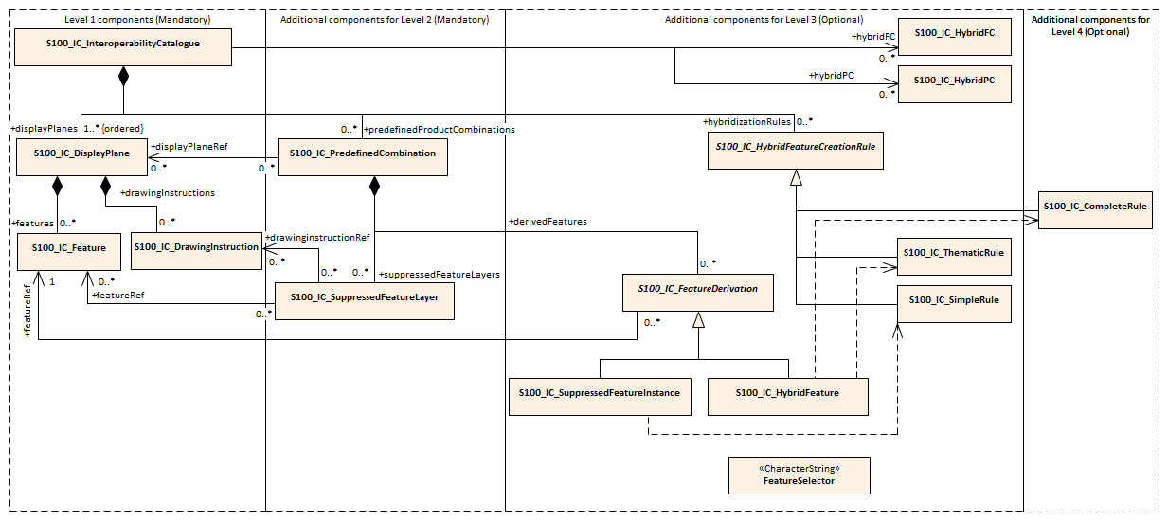
Interoperability Levels

